Slide 1
COMPILER DESIGN (CS 1703)
INTRODUCTION TO LR PARSERS

Slide 2
LR PARSERS
Efficient, Bottom-up syntax analysis that can parse a large class of CFG.
Technique is called LR(k) parsing: ‘L’ represents Left to Right scanning, ‘R’ represents righty-most derivation in the reverse and ‘k’ represents the number of input symbols of look ahead that can be used for taking parsing decisions. When (k) is omitted, it is assumed to be 1.

Slide 3
Advantages of LR parsers
Can be used for recognizing virtually all programming language constructs for which a CFG can be written.
It is the most general non back-tracking shift-reduce parsing method known.
Class of grammars that can be parsed using LR methods is a proper superset of the class of grammars that can be parsed with predictive parsers.
Can detect a syntactic error as soon as it is possible to do so on a left-to-right scanning of the input.

Slide 4
Principal drawback: Too much work needs to be done in order to design an LR parser by hand for a typical programming language grammar. But specialized LR parser generators are available. (Ex: YACC).

Slide 5
Types of LR parser
LR(0)
SLR : Simple LR- easiest to implement.
CLR(1): Canonical LR- Most powerful and most expensive.
LALR(1): Look-Ahead LR- Intermediate in power.

Slide 6
Working of LR Parser
Input buffer
Stack
LR parsing Program
Output
Action
LR parsing table
Goto

Slide 7
Working of LR Parser contd..
LR parser consists of an input, an output, a stack, a driver program and a parsing table that has two functions
1. Action
2. Goto
The driver program is same for all LR parsers. Only the parsing table changes from one parser to another.

Slide 8
Working of LR Parser contd..
The parsing program reads character from an input buffer one at a time, where a shift reduces parser would shift a symbol; an LR parser shifts a state.
Each state summarizes the information contained in the stack.
States represent a set of “items”

Slide 9
Program uses a stack to store a string of the form s₀X₁s₁X₂s₂…….X_{m}s_{m}, after reading from the input buffer one at a time. Each X_{i} is a grammar symbol and s_{i} is a state.
Parser table is divided into 2 parts namely:
1. Action.
2. Goto.

Slide 10
Behaviour of the LR parser is as follows:
it determines s_{m} … on the top of the stack and a_{i ,} the current input symbol. It then consults action[], the parsing action table entry for state s_{m} and a_{i,} which can have any of the four values:
1. Shift s, where s is a state.
2. Reduce by a grammar by the rule A→β
3. Accept
4. Error.

Slide 11
The Goto function takes a state and grammar symbols as arguments and produces a state.
A configuration of an LR parser is a pair whose first component is the stack contents and the second component is the unread input represented as:
(s₀X₁s₁X₂s₂…….X_{m}s_{m,} a_{i} a_{i+1} a_{i+2 ………} a_{n} $)
It represents the right sentential form:
X₁ X₂…….X_{m} a_{i} a_{i+1} a_{i+2 ………} a_{n}

Slide 12
LR(0) Parser
An LR(O)parser is a shift-reduce parser that uses zero tokens of look-ahead to determine what action to take (hence the 0).
This means that in any configuration of the parser, the parser must have an unambiguous action to choose-either it shifts a specific symbol or applies a specific reduction.
If there are ever two or more choices to make, the parser fails and the grammar is not LR(O).

Slide 13
LR(0) Parser
LR(O) Items:
An LR(O) item of a grammar G is a production of G with a dot at some position of the body.
Example:
A → •XYZ
One collection of set of LR(O) items, called the canonical LR(O) collection, provides finite automaton that is used to make parsing decisions.
Such an automaton is called an LR(O) automaton.

Slide 14
LR(0) Items
A → •XYZ
A→X •YZ
A→XY•Z
A→XYZ•
A→ε will generate only one item, A→ •

Slide 15
LR(0) Parser
Closure of item sets:
If I is a set of items for a grammar G, then CLOSURE(I) is the set of items constructed from I by the two rules.
Initially, add every item I to CLOSURE(I).
If A —> α • Bβ is in CLOSURE(I) and B —> ɣ is a production, then add the item B —> • ɣ to CLOSURE(I), if it is not already there. Apply this rule until no more items can be added to CLOSURE (I).

Slide 16
LR(0) Parser
S→AA
A→aA|b

Slide 17
LR(0) Parser
1. Add a production grammar: Augment the grammar
S’ → S
S→AA
A→aA|b

Slide 18
LR(0) Parser
2. Generate the items and closures:
S’ → • S
Include productions of S closure
S→ • AA
Include production of A closure
A→ • aA | • b
S→AA
A→aA|b

Slide 19
LR(0) Parser
S’ → S •
S’ → • S
S→ • AA
A→ • aA
A→ • b
S
A
S→ A • A
A→ • aA | • b
a
A→ a • A
A→ • aA | • b
b
A→ b •

Slide 20
LR(0) Parser
S’ → S •
S’ → • S
S→ • AA
A→ • aA
A→ • b
S
A
S→ A A •
A
S→ A • A
A→ • aA | • b
a
A→ a • A
A→ • aA | • b
a
A→ a • A
A→ • aA | • b
A
A→ a A •
b
a
A→ a • A
A→ • aA | • b
b
A→ b •
A→ b •

Slide 21
LR(0) Parser
S’ → S •
S’ → • S
S→ • AA
A→ • aA
A→ • b
S
A
S→ A A •
A
S→ A • A
A→ • aA | • b
a
a
a
A→ a • A
A→ • aA | • b
A
A→ a A •
b
b
A→ b •
b

Slide 22







LR(0) Parser
$$I_{0}$$
$$I_{1}$$
S’ → S •
S’ → • S
S→ • AA
A→ • aA
A→ • b
S
$$I_{5}$$
$$I_{2}$$
A
A
S→ A • A
A→ • aA | • b
S→ A A •
a
a
$$I_{3}$$
a
$$I_{6}$$
A→ a • A
A→ • aA | • b
A
A→ a A •
b
b
A→ b •
b
$$I_{4}$$

Slide 23
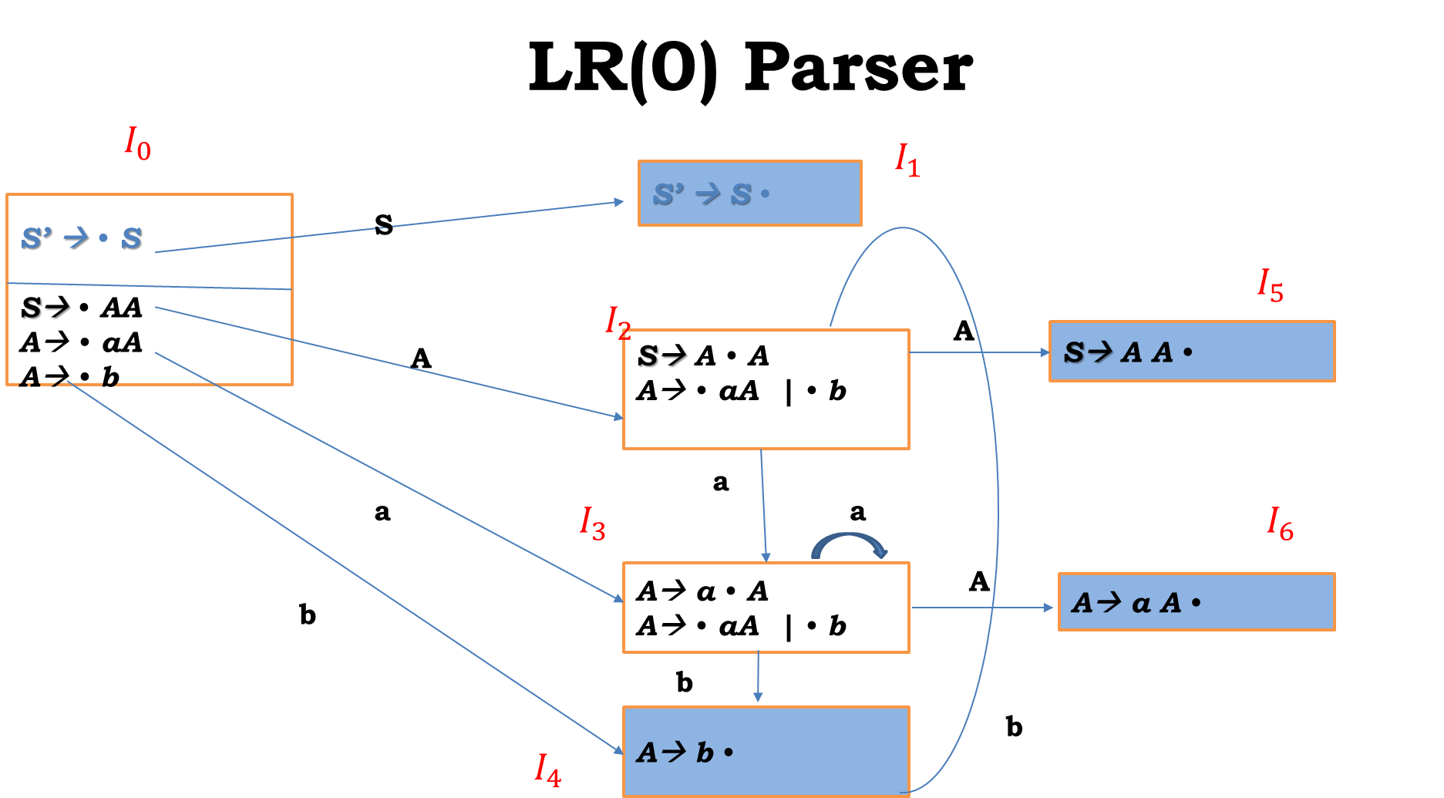
LR(0) Parsing Table
 | Action |  |  | Goto
States | a | b | $ | A | S
0
1
2
3
4
5
6
1. S→AA
2. A→aA
3. A→b

Slide 24
LR(0) Parsing Table
 | Action |  |  | Goto
States | a | b | $ | A | S
0 | S3 | S4 |  | 2 | 1
1 |  |  | Accept
2 | S3 | S4 |  | 5
3 | S3 | S4 |  | 6
4 | r3 | r3 | r3
5 | r1 | r1 | r1
6 | r2 | r2 | r2
1. S→AA
2. A→aA
3. A→b

Slide 25
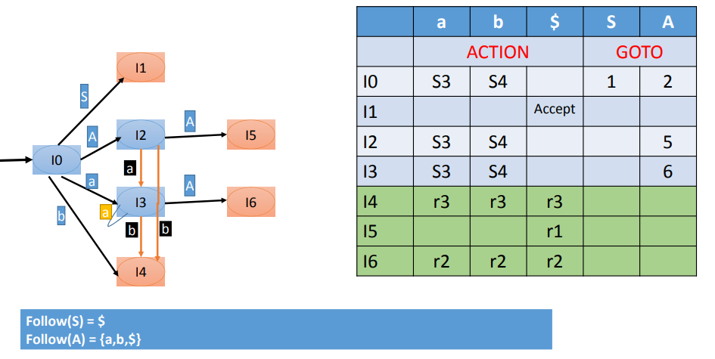
SLR(1) Parsing Table

Slide 26
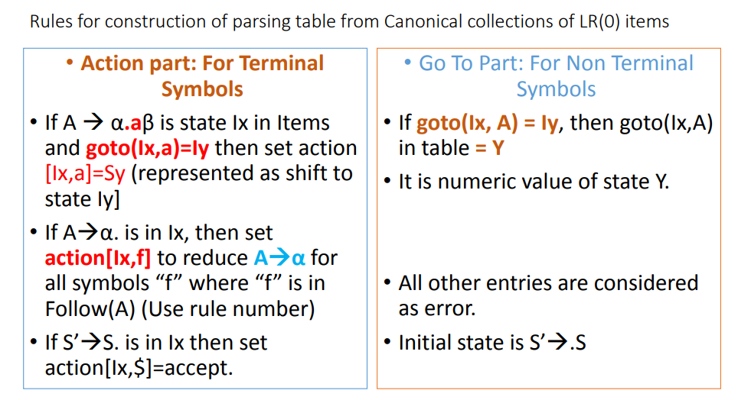

Slide 27
Steps in processing of the string abb
Stack | Input | Action
$0 | abb$ | Shift 3
$0a3 | bb$ | Shift 4
$0a3b4 | b$ | Reduce by A→b
$0a3A | b$ | Goto 6 (Intermediate Step)
$0a3A6 | b$ | Reduce by A→aA
$0A | b$ | Goto 2 (Intermediate Step)
$0A2 | b$ | Shift 4
$0A2b4 | b$ | Reduce by A→b
$0A2A5 | $ | Reduce by S→AA
$0S1 | $ | Accept

Slide 28
Consider the grammar below:
A → (A)
A → a
The corresponding Augmented grammar can be written as:
A’ → A -----→ 1
A → .(A) ---→ 2
A → .a ----→ 3

Slide 29
This grammar has eight items in its closure set:
A' → ·A
A' → A·
A → ·(A)
A → (·A)
A → (A·)
A → (A)·
A → ·a
A → a·

Slide 30
DFA construction of closure sets

Slide 31
LR(0) Parsing Table
 | Action |  |  |  | Goto
States | ( | a | ) | $ | A
0 | s3 | s2 |  |  | 1
1 |  |  |  | Accept
2 | r3 | r3 | r3
3 | s3 | s2 |  |  | 4
4 |  |  | S5
5 | r2 | r2 | r2
Augmented Grammar:
A’ →.A --→ 1
A → .(A) -→ 2
A → a ---→ 3

Slide 32
SLR(1), called simple LR(1) parsing, uses the DFA of sets of LR(0) items .
SLR(1) increases the power of LR(0) parsing significant by using the next token in the input string.
First, it consults the input token before a shift to make sure that an appropriate DFA transition exists.
Second, it uses the Follow set of a non-terminal to decide if a reduction should be performed.

Slide 33
Definition of The SLR(1) parsing algorithm(1)
Let s be the current state,
actions are defined as follows: .
1.If state s contains any item of form A → α·Xβ
where X is a terminal, and
X is the next token in the input string,
then to shift the current input token onto the stack,
and push the new state containing the item
A → αX·β
2. If state s contains the complete item A → γ·,
and the next token in input string is in Follow(A)
then to reduce by the rule A → γ

Slide 34
Definition of The SLR(1) parsing algorithm(2)
2. (Continue)
A reduction by the rule S' →S, is equivalent to acceptance;
This will happen only if the next input token is $.
In all other cases, Remove the stringγ and a corresponding states from the parsing stack
Correspondingly, back up in the DFA to the state from which the construction of γ began.
This state must contain an item of the form B → α·Aβ.
Push A onto the stack, and the state containing the item
B → αA·β.

Slide 35
Definition of The SLR(1) parsing algorithm(3)
3. If the next input token is such that neither of the above two cases applies,
an error is declared

Slide 36
A grammar is an SLR(l) grammar if the application of the above SLR( 1 ) parsing rules results in no ambiguity
A grammar is SLR( 1) if and only if, for any state s, the following two conditions are satisfied:
For any item A → α·Xβin s with X a terminal,
There is no complete item B → γ. in s with X in Follow(B).
For any two complete items A → α·and B →β· in s, Follow(A) ∩ Follow(B) is empty.
A violation of the first of these conditions represents a shift-reduce conflict.
A violation of the second of these conditions represents a reduce-reduce conflict.

Slide 37
SLR(1) Parsing Table
 | Action |  |  |  | Goto
States | ( | a | ) | $ | A
0 | s3 | s2 |  |  | 1
1 |  |  |  | Accept
2 |  |  | r3 | r3
3 | s3 | s2 |  |  | 4
4 |  |  | S5
5 |  |  | r2 | r2
Augmented Grammar:
A’ →.A → 1 FOLLOW (A’)={$}
A → .(A) → 2 FOLLOW (A)={),$}
A → a → 3

Slide 38
Steps in processing of the string ((a))
Stack | Input | Action
$0 | ((a))$ | Shift
$0(3 | (a))$ | Shift
$0(3(3 | a))$ | Shift
$0(3(3a2 | ))$ | Reduce by A →a
$0(3(3A4 | ))$ | Shift
$0(3(3A4)5 | )$ | Reduce by A→(A)
$0(3A4 | )$ | Shift
$0(3A4)5 | $ | Reduce by A→(A)
$0A1 | $ | Accept

